Slide 1
Autonomous vehicles and smart cities

Slide 2
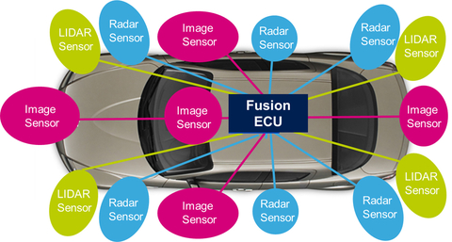
Sensors used in autonomous cars

Slide 3
Camera sensors
Computer Vision: Camera vision eliminates or resolves the impediments noticed across the LIDAR-based approach.In this approach, digital cameras try to interpolate a 3D world around the car. Also, camera vision technology can automate driving by 90%.
The cameras receive and process data in a 2D, or stereoscopic-pseudo-3D representation of the world. This is different from actual 3D data points as one gets with LIDAR. The computer processing required to interpolate and actually understand the 3D world from this 2D data is immensely complex, and thus financially expensive as well.
https://analyticsindiamag.com/tesla-google-autonomous-car-technologies-different/

Slide 4
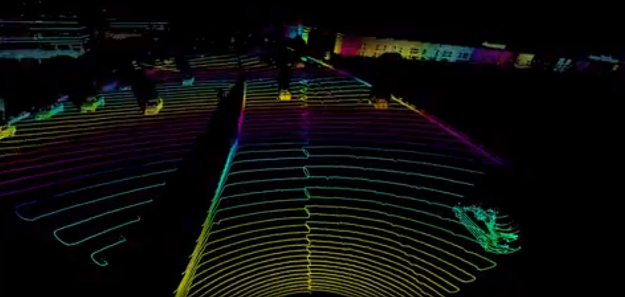
Lidar (LIght Detection And Ranging)
LIDAR Technology
Disadvantages:
The technology proves complicated with moving parts
The 3D model of the world appears in low-resolution
It has relatively modest ranges of only up to 100 meters

Slide 5
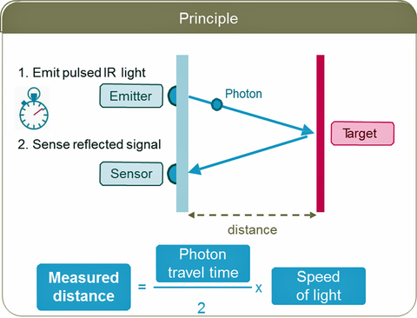
Working principle

Slide 6
Radar (RAdio Detection And Ranging)
RADAR has been used in automotive for decades and can determine the velocity, range and angle of objects.
Long Range Radar (LRR) is the defacto sensor used in Adaptive Cruise Control (ACC) and highway Automatic Emergency Braking Systems (AEBS).
Both RADAR and LIDAR waves travel at the speed of light, but the wavelength of Light helps in detecting the smaller objects.

Slide 7
Ultrasonic sensors
Use Sound waves to measure the distance of an object
Used in Tesla-S vehicles

Slide 8
V2X technology
Vehicle to Anything
Enable Communication among vehicles to detect incoming vehicles at the turns and intersections.
Requires Cloud of Fog computers for processing.
Required for Smart Traffic Lighting system

Slide 9
Requirements of a smart city
efficient delivery of public utilities such as water, electricity, solid waste, sanitation, and sewerage as well as associated government services
mechanism for supply-demand matching of surface transport services to provide congestion free roads, and minimal waiting time for public transport commuters
active surveillance, monitoring and alerts at vantage points in the city to provide the much required public safety for citizens
on-demand availability of reliable emergency services such as ambulance, fire safety.

Slide 10
Technical requirements
Sensors that monitor the condition of utilities such as electricity, water supply, load on surface transport and capture real-time data;
Gateways that aggregate real-time data from these sensors, perform local analytics and based on the result, take localised action to prevent possible faults from further propagating into the networks
Communication infrastructure to connect these gateways to server cloud for transmitting data on condition of local area;
Server farms in a cloud based architecture that warehouses the data; perform real-time mining of such data to provide useful information to various stakeholders through various channels such as mobile devices.

